Slide 1
Virtual Dressing Room: Smart approach to select and buy clothes
Project ID : 2021-153

Slide 2
Introduction
Nowadays most of the people do not have a time to spend for themselves because busy lifestyle.
So, they do not intend to delaying in physical clothing stores because it waste a lots of time either a cloth is purchased or not.
People have a more intend to proceed with online platforms to avoid above problems.
But online platforms are limited in facilities rather than traditional shopping style.
The research is to propose a solution to avoid the most common issues in online shopping and provide much better shopping experience through mobile phone.

Slide 3
Research Problem
People are making mistakes when determining exact sizes when selecting clothes in online shops.
Some people have a lack of identifying the best matching colors suitable for them.
Most people complain, the cloth is not looks good after wearing, although they selected the clothes without having size mismatches.
Online cloth shops do not have sales assistants to assist the customers when selecting clothes.
Maintain the stock with most demanding clothing items is a better way of improve the customer satisfaction rather than saying item is out of stock.

Slide 4
Research Objectives
Main objective : developing a smart ordering system for a clothing store while providing the ability to the users to fit-on the clothes virtually and pre order the desired clothes in an efficient way.
Suggest the most suitable clothing items
Provide virtual fit-on room facility
Provide assist of an intelligent bot
Generate future predictions on clothing items by analyzing customers’ purchasing data
Maintain a preferable stock to supply trending clothing items in applicable periods throughout the year.

Slide 5
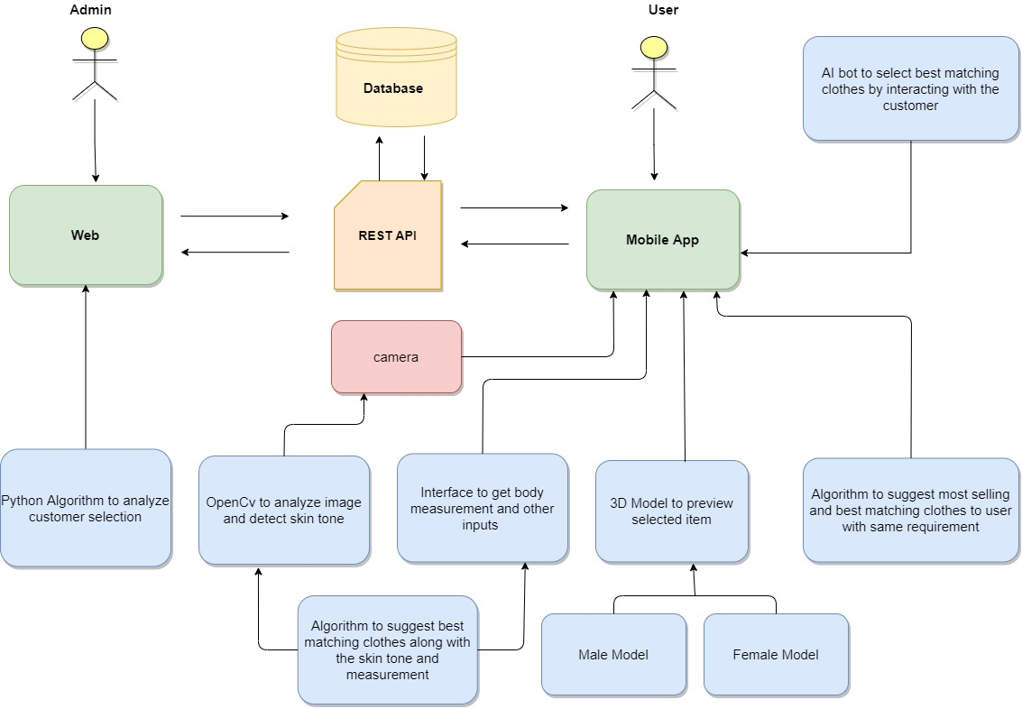
System Diagram

Slide 6
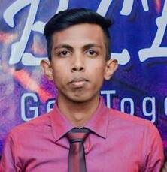
IT18001808 | S.W.P.N.M.Weerasinghe
B.Sc. (Hons) Degree in Information Technology Specialized in Software Engineering
IT18001808 | S.W.P.N.M.Weerasinghe | 2021-153

Slide 7
Suggest Best Matching Clothes Based on Skin tone and Body Measurements
IT18001808 | S.W.P.N.M.Weerasinghe | 2021-153

Slide 8
Research Question
How to capture Only the face?
How to identify customer skin tone?
When try to Identify skin tone, How to do that on low quality images?
How to categorized different skin tone variation?
How to suggest best matching dress color to identified skin tone?
How to suggest best matching clothes based on skin tone and body measurement?
IT18001808 | S.W.P.N.M.Weerasinghe | 2021-153

Slide 9
Objectives
Identify customer face
Identify skin tone accurately & efficiently
Collect Customer Body measurements
Suggest matching dress color to the customer
IT18001808 | S.W.P.N.M.Weerasinghe | 2021-153

Slide 10
Methodology
IT18001808 | S.W.P.N.M.Weerasinghe | 2021-153

Slide 11
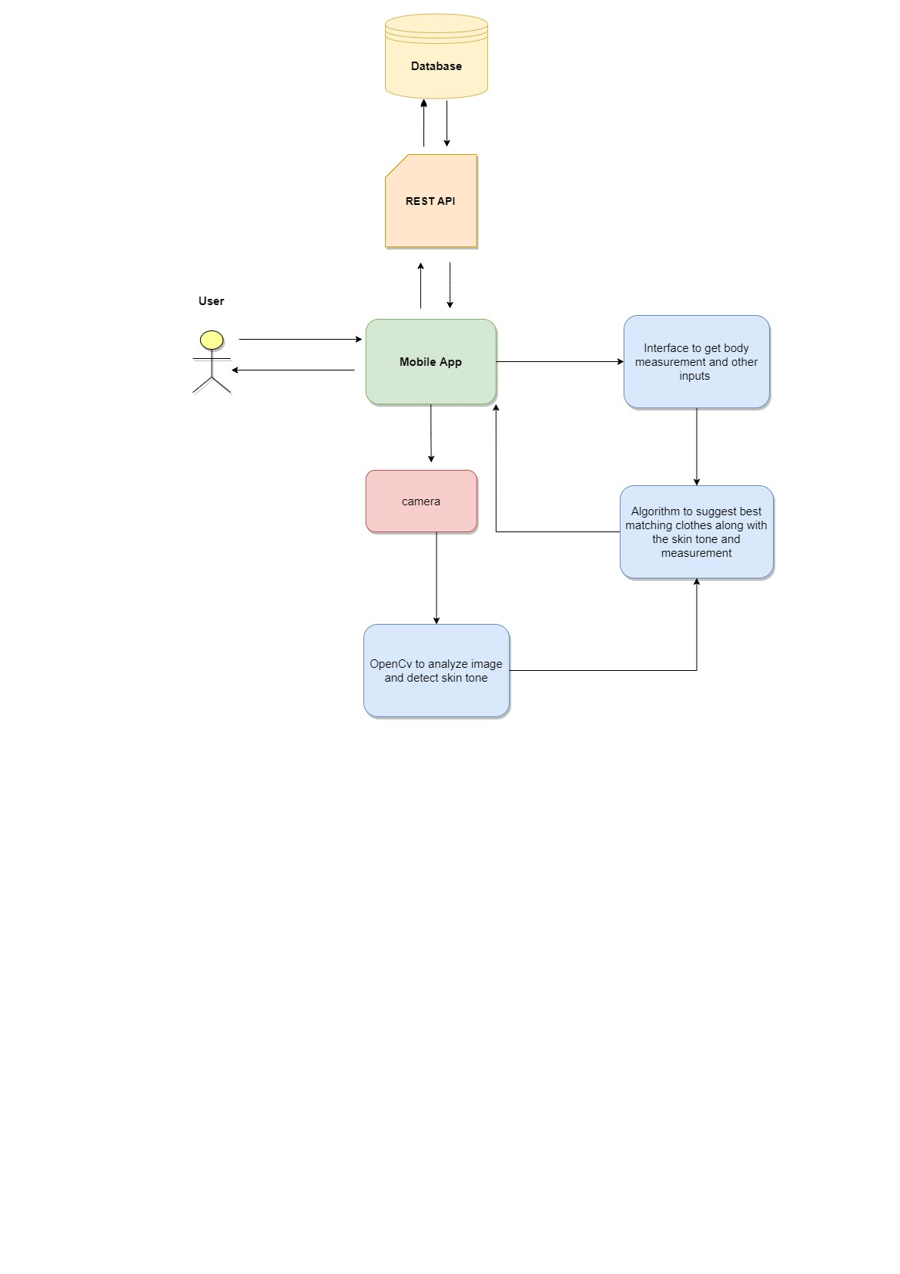
System Diagram
IT18001808 | S.W.P.N.M.Weerasinghe | 2021-153

Slide 12
Functional Requirement
Smart Phone
Clear Background
Internet Connection
Identify best matching color to the skin
Identify matching clothes to the user body measurement
Filter out best matching cloth set based on skin tone and measurement

Slide 13
Completion of The Project
Completed | Have To Complete
Face detection | Integrate with Real Data
Identify Skin tone | Improve Filter Items
Suggest Best matching Dress Color | Finalize the flow
Collect Body Measurement
Detect Relevant Clothes size
Filter Matching clothes
Smart Phone
Clear Background
Internet Connection

Slide 14
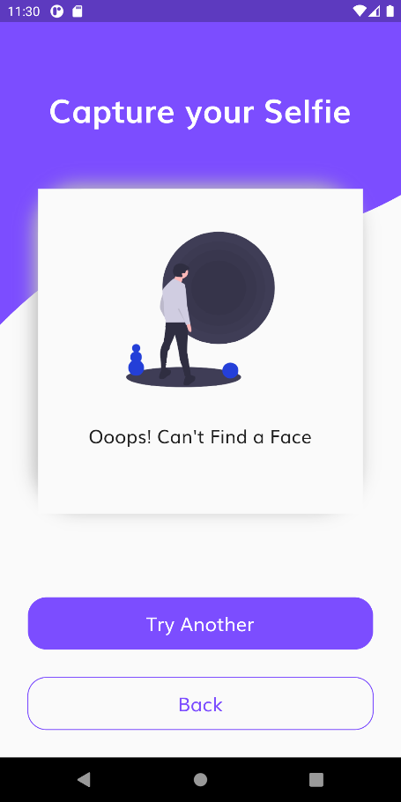
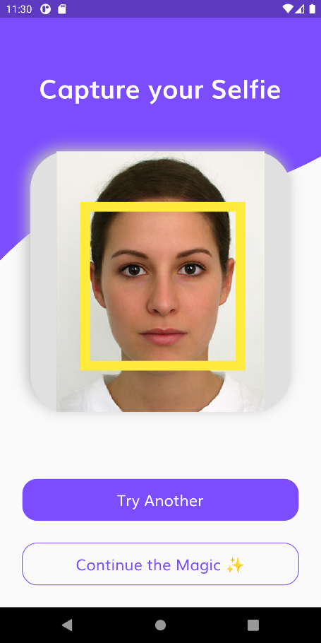
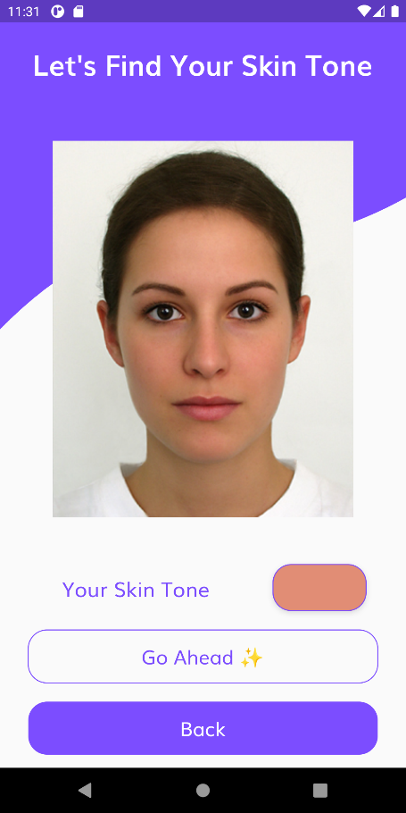
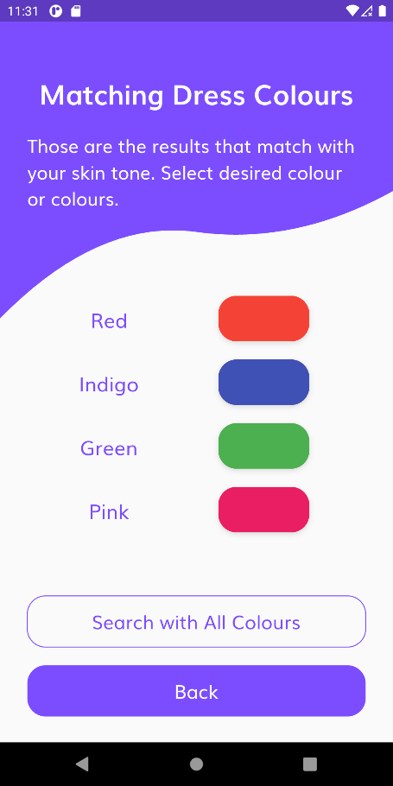
Completion of The Project
Smart Phone
Clear Background
Internet Connection

Slide 15

IT18012866 | L.G.I Sathsara
B.Sc. (Hons) Degree in Information Technology Specialized in Software Engineering
IT18012866 | L.G.I Sathsara | 2021-153

Slide 16
Render a Female 3D Model
IT18012866 | L.G.I Sathsara | 2021-153

Slide 17
Research Question
How to render the 3D model?
Is the model change the skin tone?
Is the model static?
How to apply clothes on the model? Are they customizable?
Can the model animate?
IT18012866 | L.G.I Sathsara | 2021-153

Slide 18
Objectives
Render a female 3D model dynamically with user’s inputs (measurements)
Apply the same skin tone which detected by the photograph
Add behavior animations to the model (female related)
Render related clothing items which can apply onto the rendered model
Make clothes customizable when applied onto the model
IT18012866 | L.G.I Sathsara | 2021-153

Slide 19
Methodology
IT18012866 | L.G.I Sathsara | 2021-153

Slide 20
System Diagram
Database
REST API
Mobile App
User Inputs for body measurements
Apply detected skin tone
Customer
Camera
Customizable Female model
Female body template
Apply suggested clothes
Detect Skin tone
IT18012866 | L.G.I Sathsara | 2021-153

Slide 21
Technologies
BLEnder
Android Studio
Flutter
UNITY
IT18012866 | L.G.I Sathsara | 2021-153

Slide 22
Functional Requirement
Smart Phone
Clear Background
Internet Connection
Virtual fitting room facility to try-out clothes virtually.
Render a dynamic female 3D model inside the room.
Make the model animative.
Make the model customizable with clothing items.

Slide 23
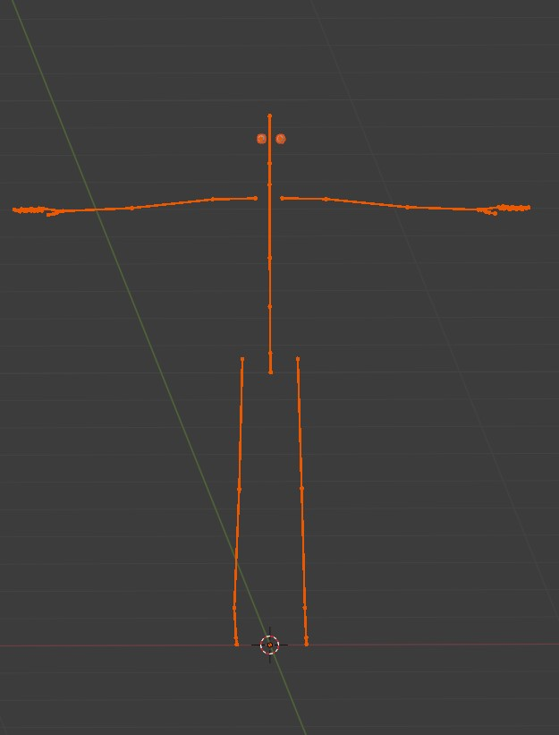
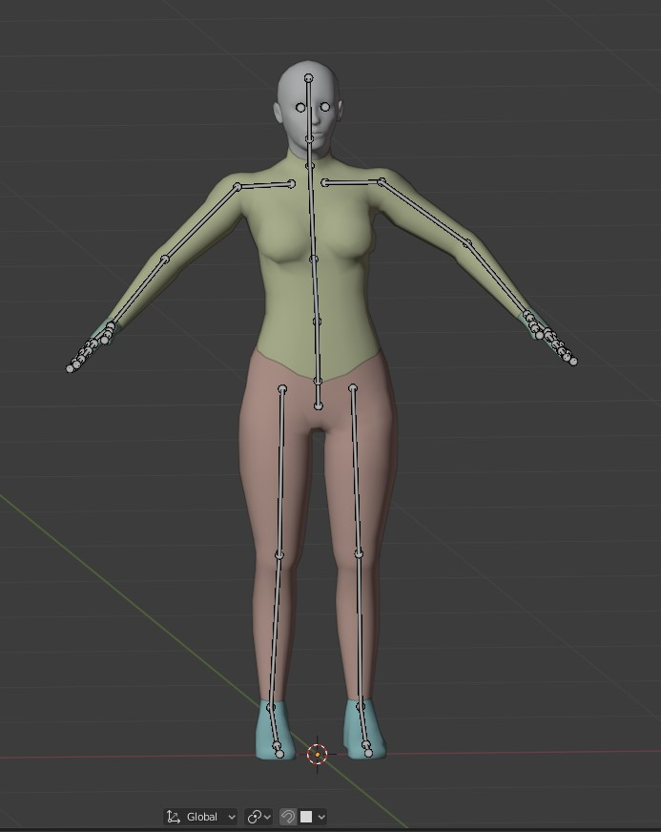
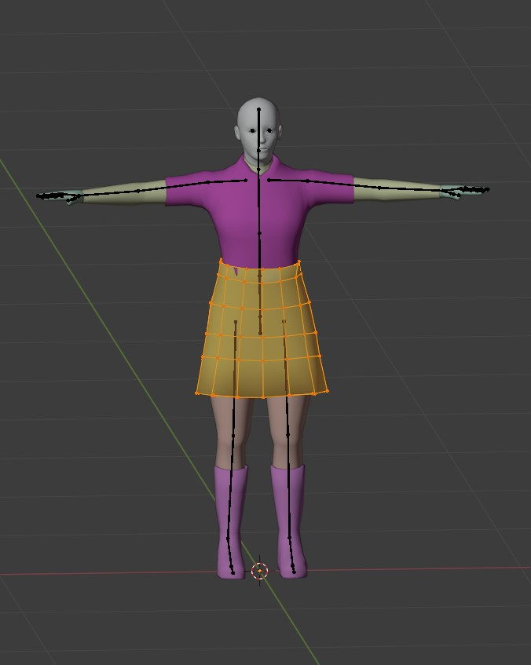
Screen Shots
Skeleton
Female Body
Female Clothes

Slide 24
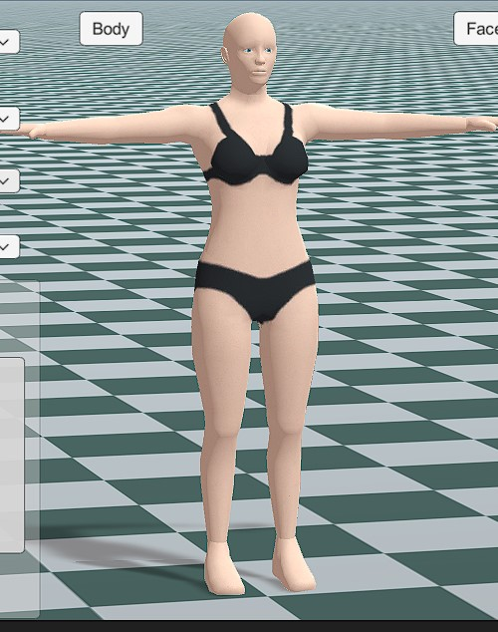
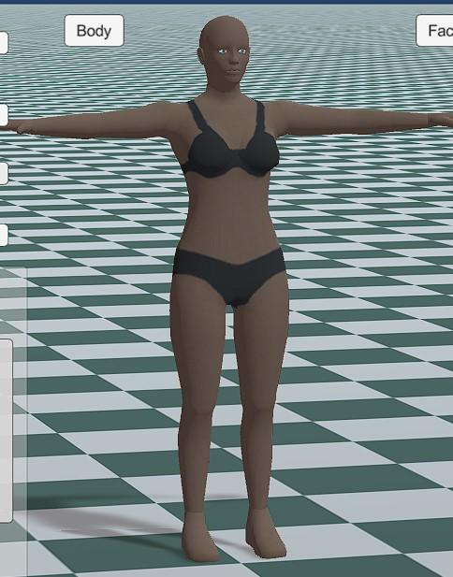
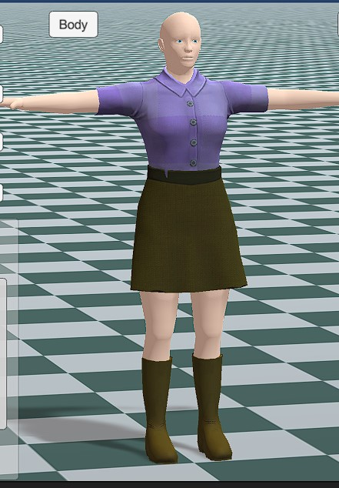
Screen Shots
Skin color - white
Skin color - black
Clothed Model

Slide 25
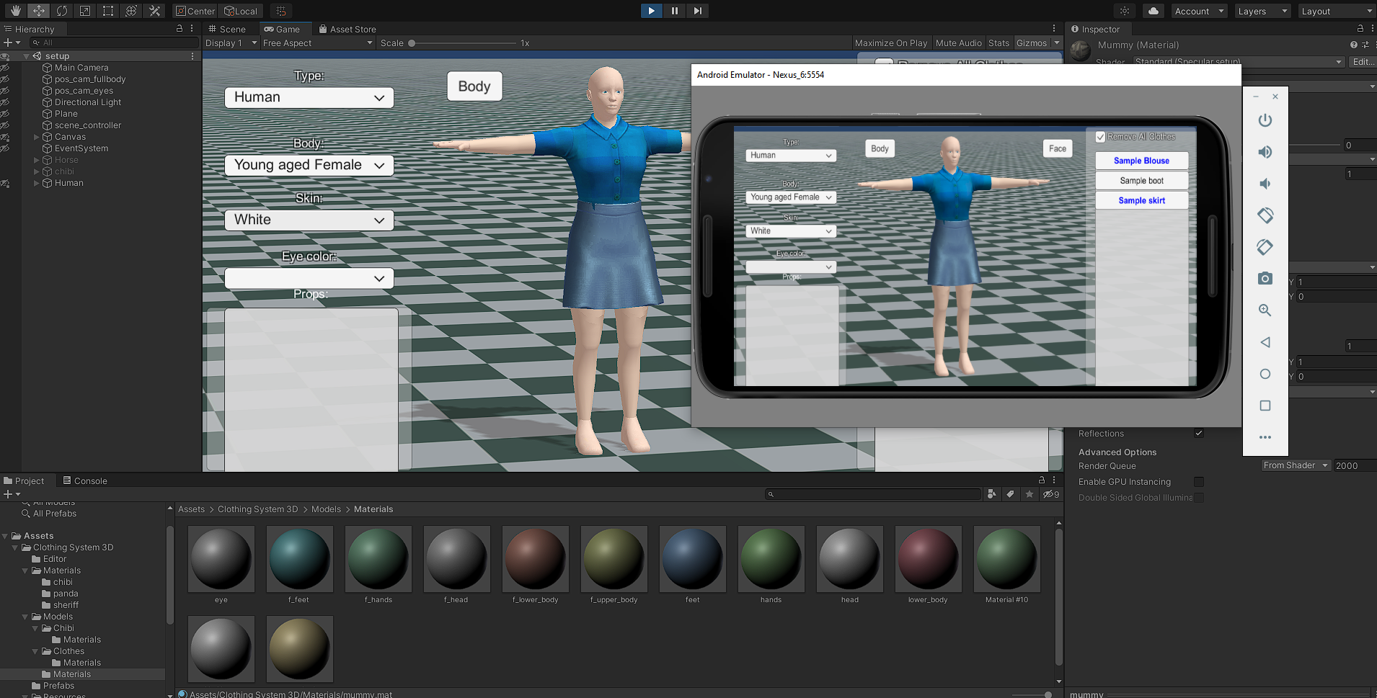
Screen Shots
Simulate in mobile environment

Slide 26
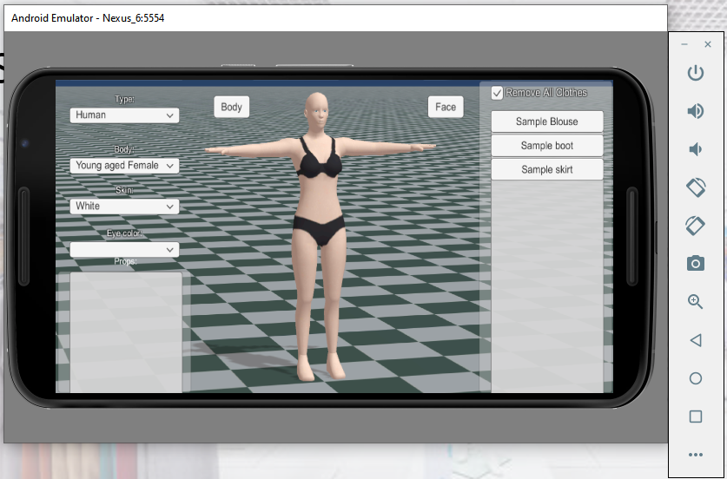
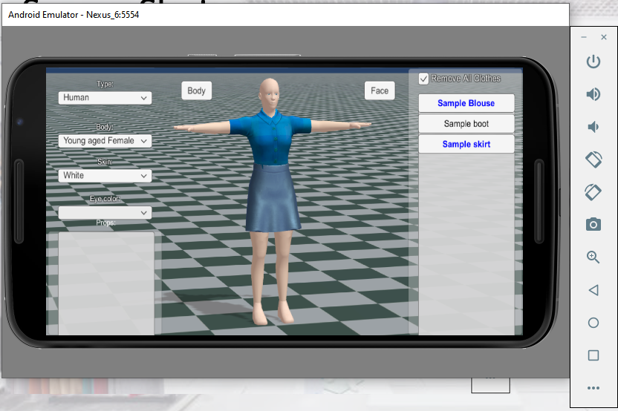
Screen Shots
Simulate in mobile environment

Slide 27
Completion of the Project
Main Requirements
Have a 3D model ….…………………….….…?
Yes
Change skin tone ………….……………….….?
Yes
Apply clothes to model …………………..…?
Yes
Operate in Mobile environment……...…?
Yes
Next improvements…
Set model rotate 360.
Make model animate.
IT18012866 | L.G.I Sathsara | 2021-153

Slide 28
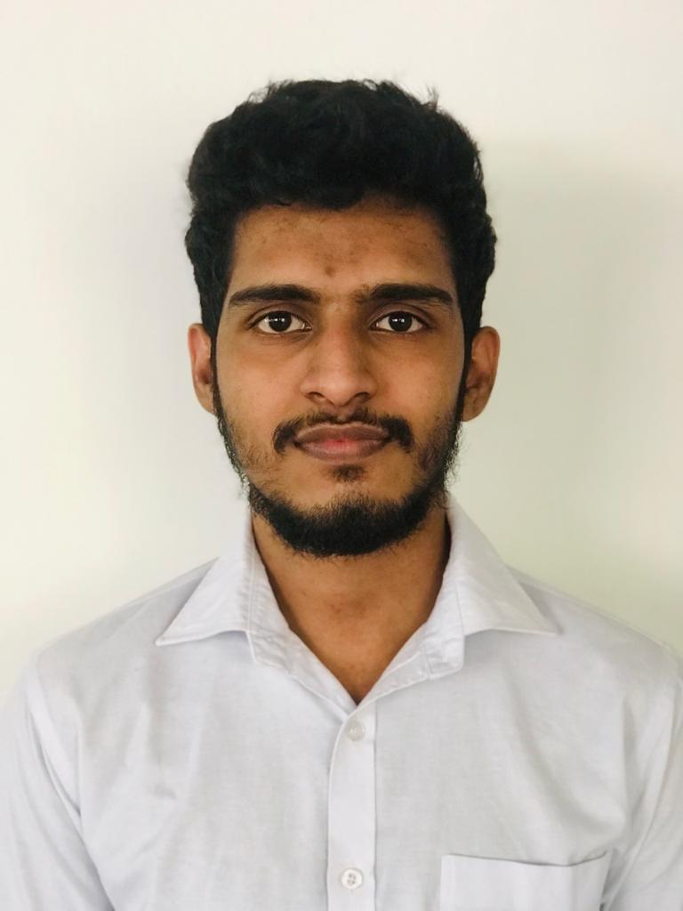
IT18066944 | R.M.D.D Rajapaksha
B.Sc. (Hons) Degree in Information Technology Specialized in Software Engineering
IT18066944 | R.M.D.D Rajapaksha | 2021-153

Slide 29
Render a Male 3D Model
IT18066944 | R.M.D.D Rajapaksha | 2021-153

Slide 30
Research Question
How to generate customized 3D model in mobile app?
How to add cloths to generated 3D model?
How to add animations to generated 3D model?
How to add skin tone to generated 3D model.?
How to add fit-on facility to 3D model?
How to display 360’ 3D model in mobile app?
IT18066944 | R.M.D.D Rajapaksha | 2021-153

Slide 31
Objectives
Generate Customizable 3D Model
Add cloths to generated 3D Model
Add fit-on facility to 3D Model
Add skin tone to 3D Model
Display 360’ 3D Model
IT18066944 | R.M.D.D Rajapaksha | 2021-153

Slide 32
Methodology
IT18066944 | R.M.D.D Rajapaksha | 2021-153

Slide 33
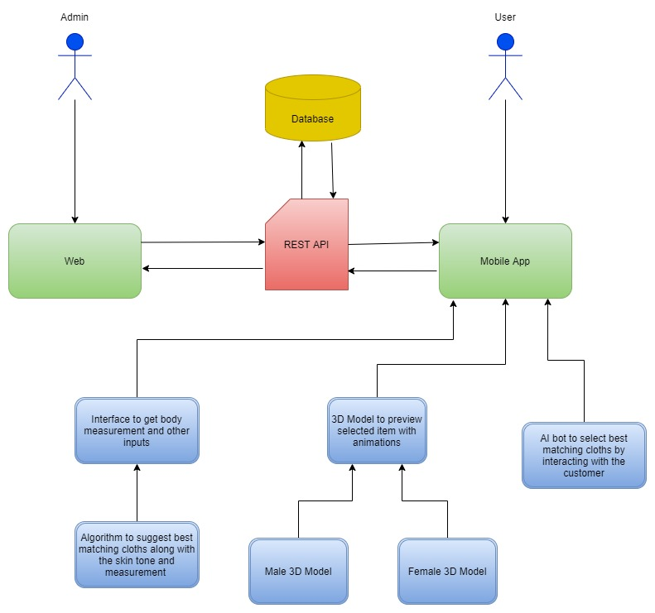
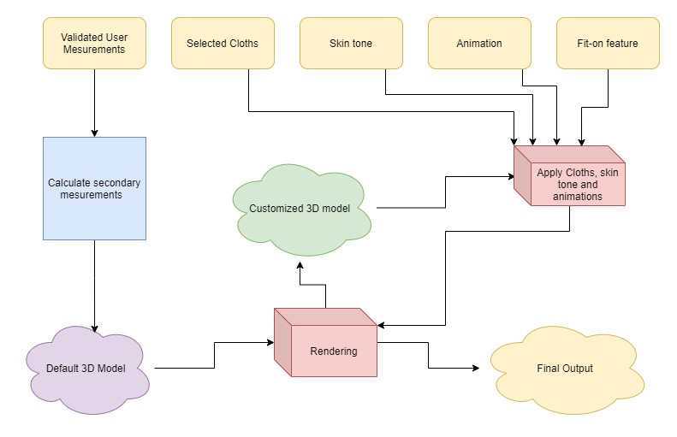
System Diagram
IT18066944 | R.M.D.D Rajapaksha | 2021-153

Slide 34
Technologies
Blender
Android Studio
Flutter
UNITY
IT18066944 | R.M.D.D Rajapaksha | 2021-153

Slide 35
Functional Requirement
Smart Phone
Clear Background
Internet Connection
Render a 3D model
Add selected cloths to 3D model
Add skin-tone to 3D model
Add fit-on facility to 3D model
Add Animation to 3D model

Slide 36
Non - Functional Requirement
Smart Phone
Clear Background
Internet Connection
Fast rendering 3D model
Clear view of 3D model
Should be easy to use
App size should be low

Slide 37
Completion of the Project
Smart Phone
Clear Background
Internet Connection
This is 90% Completion
Generate 3D Model
Add Clothes to 3D Model
Add Skin Tone To 3D Model
Convert to Mobile Platform
For Future
Display 360 3D Model
Add Animation to 3D Model

Slide 38
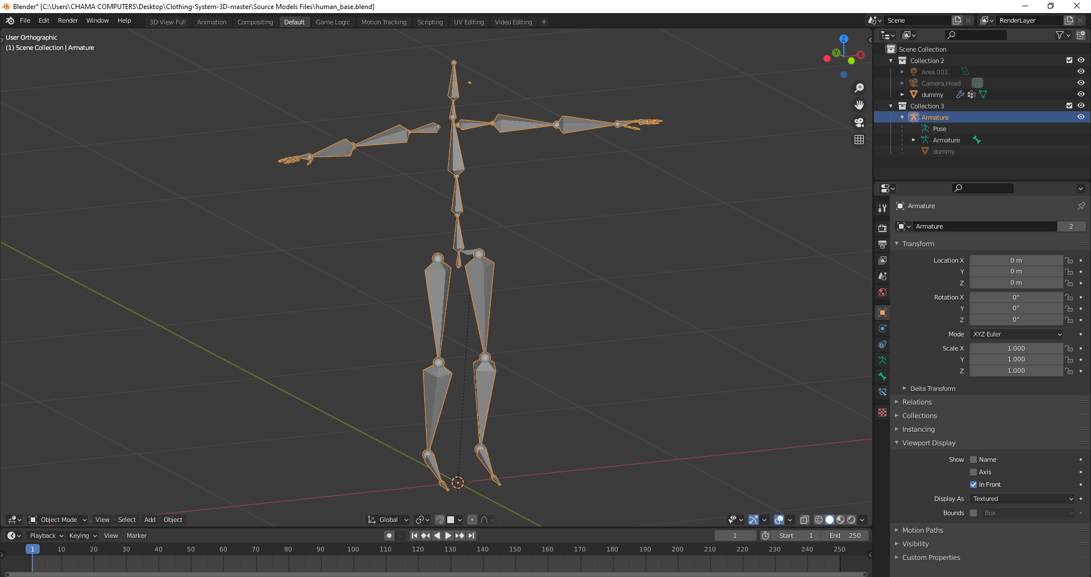
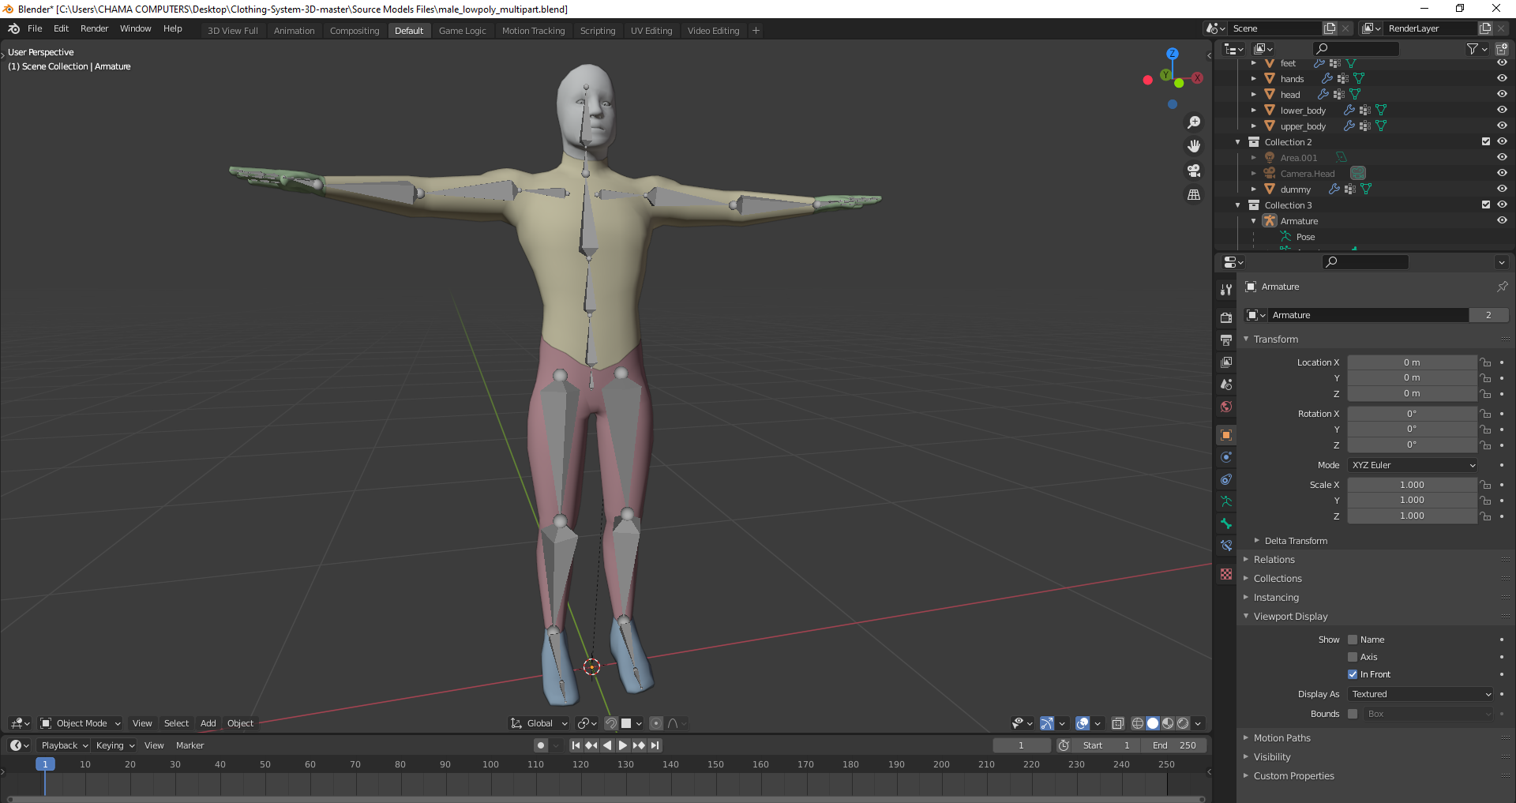
Completion of the Project
Smart Phone
Clear Background
Internet Connection

Slide 39
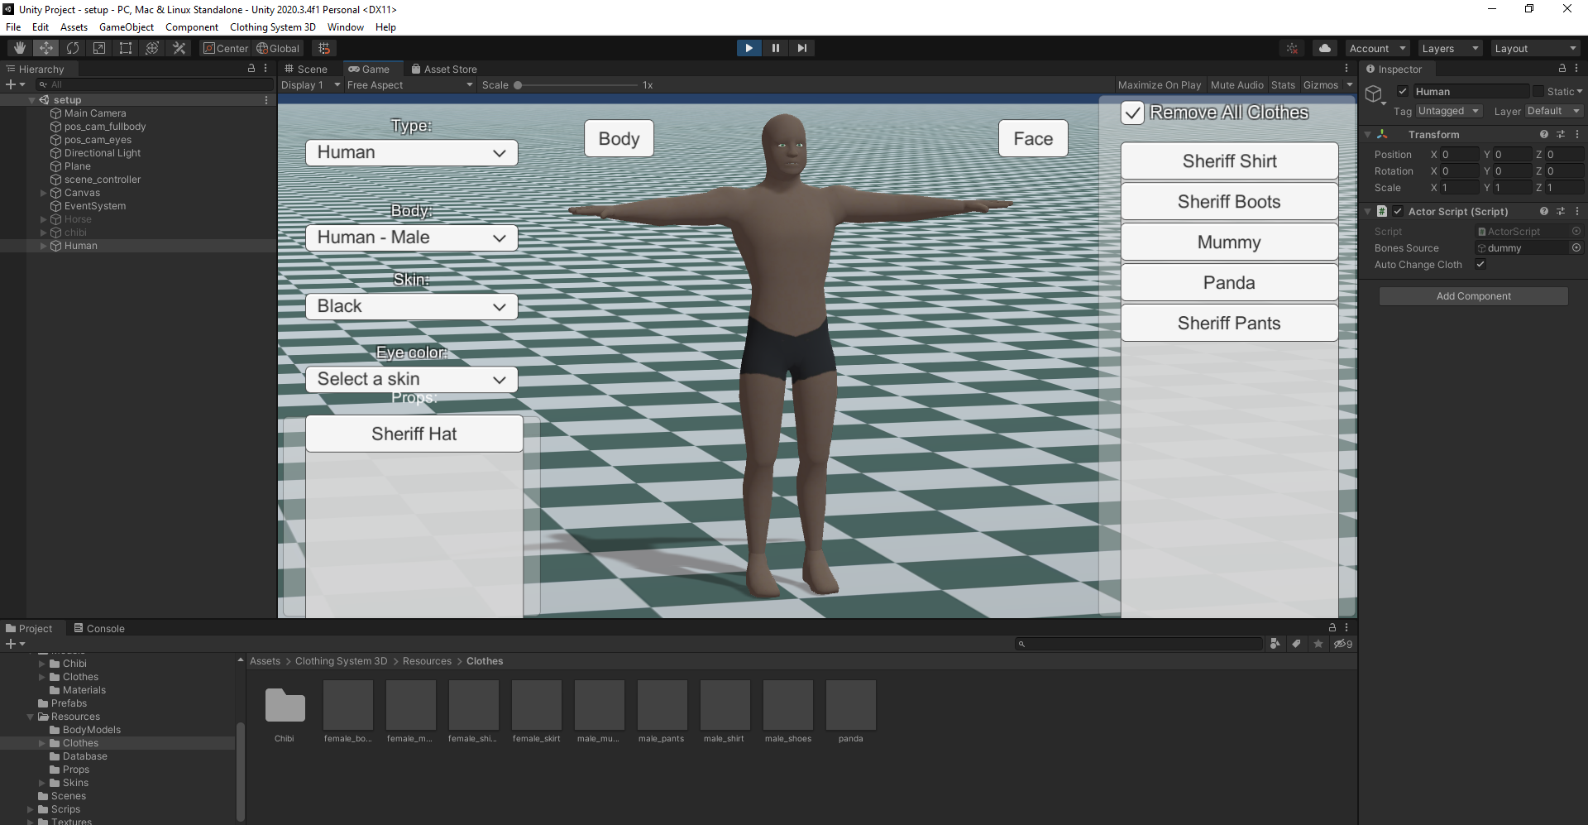
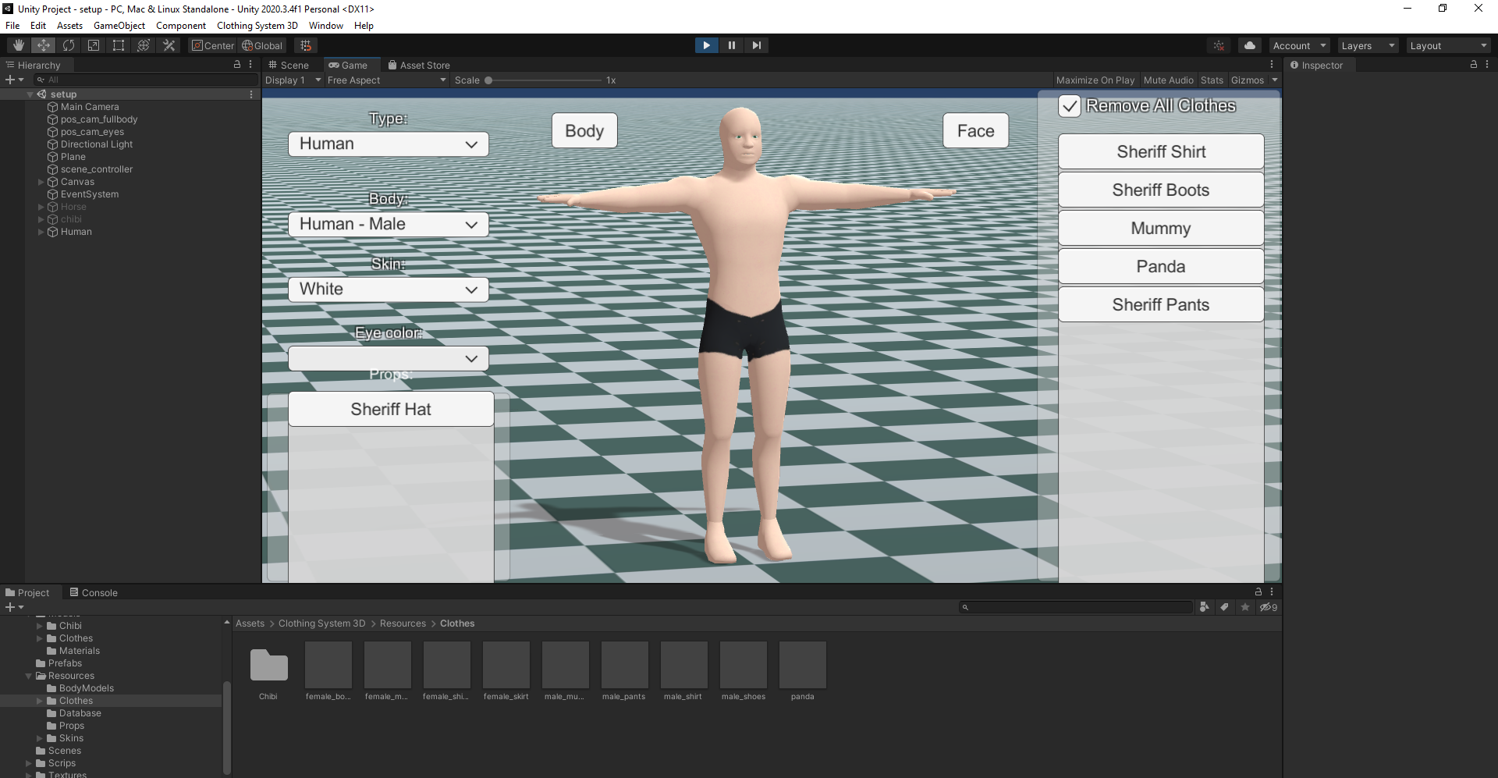
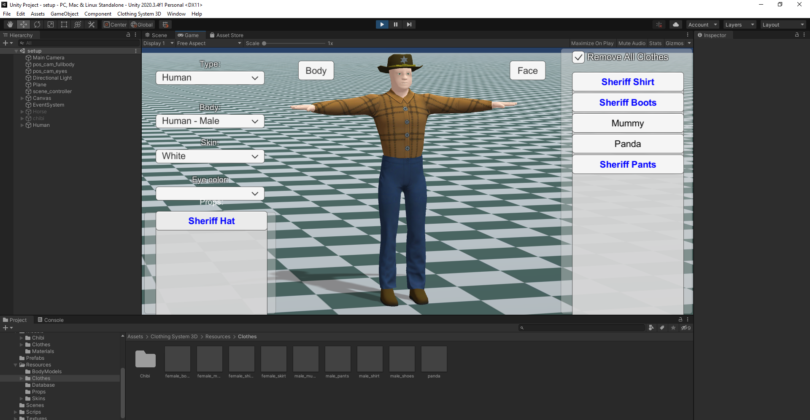
Completion of the Project
Smart Phone
Clear Background
Internet Connection

Slide 40
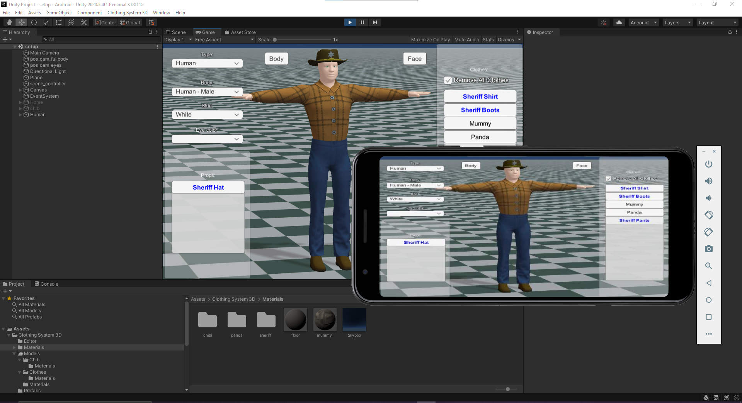
Completion of the Project
Smart Phone
Clear Background
Internet Connection

Slide 41
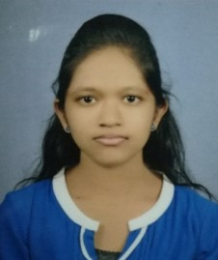
IT17084796 |H.S.D.N Gunasekara
B.Sc. (Hons) Degree in Information Technology Specialized in Software Engineering
IT17084796 | H.S.D.N Gunasekara | 2021-153

Slide 42
Future fashion trends prediction component & AI powered chatbot with suggestions and recommendations
IT17084796 | H.S.D.N Gunasekara | 2021-153

Slide 43
Research Question
How to implement a prediction component for predicting future fashion trends?
How to implement an AI chatbot for assist customers?
How to implement suggestions features?
IT17084796 | H.S.D.N Gunasekara | 2021-153

Slide 44
Objectives
Provide a feature for predict future fashion trends
Provide an AI chatbot assistant to the customer for cloth selection and purchase process
Commit an accurate predictive analysis results
Ensure the accuracy of chatbot assistant
IT17084796 | H.S.D.N Gunasekara | 2021-153

Slide 45
Methodology
IT17084796 | H.S.D.N Gunasekara | 2021-153

Slide 46
Future Fashion Trends Prediction Component
Data collection and data analysis
Collect data and preprocessing the collected data set while omitting unwanted data.
Trained model using ML algorithm
Utilize supervised learning algorithm to train the module using collected data set.
Evaluation
Future demand prediction for existing and new clothing items
Compare and contrast actual values and predicted values
IT17084796 | H.S.D.N Gunasekara | 2021-153

Slide 47
Technologies
Python Library
Reactjs
MongoDB
Nodejs
IT17084796 | H.S.D.N Gunasekara | 2021-153

Slide 48
AI Chatbot Assistant
Analyze the text-based user inputs and determine the user intention
Responds to the user with appropriate outputs
Provide cloth suggestions
Recommend clothing items using the purchase records of past users
IT17084796 | H.S.D.N Gunasekara | 2021-153

Slide 49
Technologies
Python
MongoDB
Nodejs
Flutter
RASA Framework
IT17084796 | H.S.D.N Gunasekara | 2021-153

Slide 50
Completion of the Project
IT17084796 | H.S.D.N Gunasekara | 2021-153

Slide 51
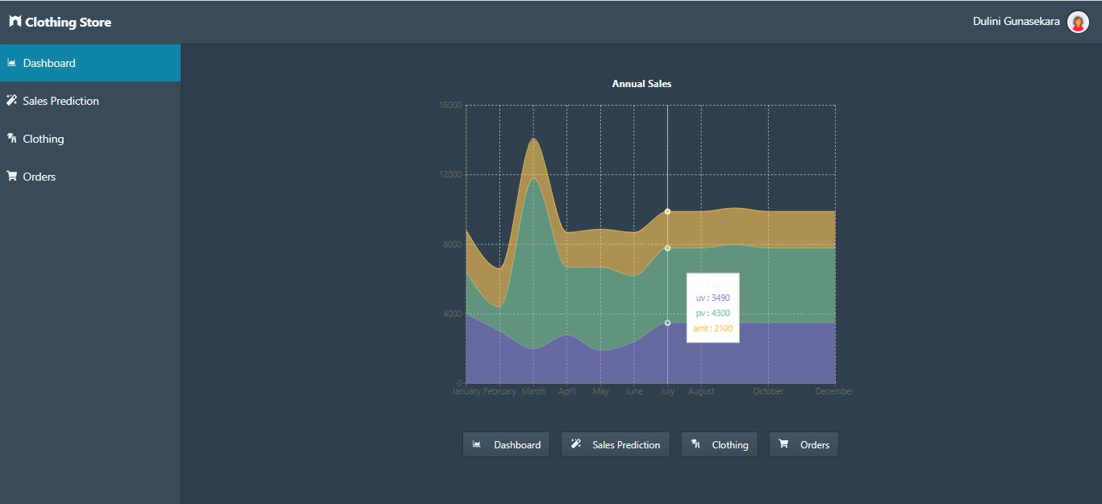
Created a prediction model for predict the sales count of a particular clothing item in a given month.
Admin Dashboard
IT17084796 | H.S.D.N Gunasekara | 2021-153

Slide 52
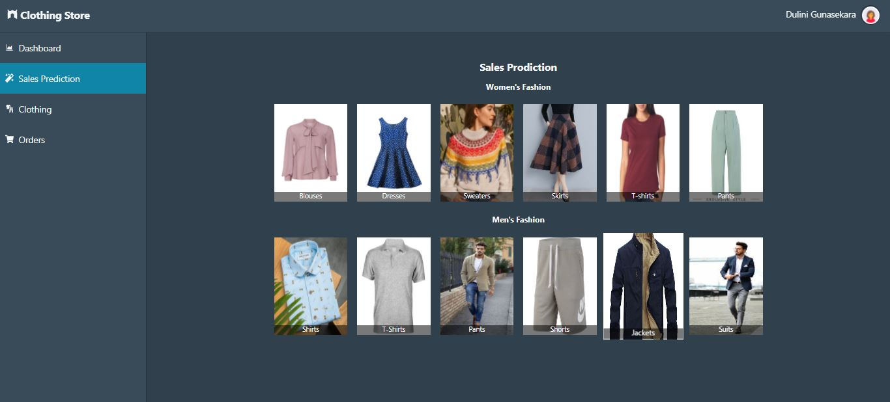
Sales Prediction UI
IT17084796 | H.S.D.N Gunasekara | 2021-153

Slide 53
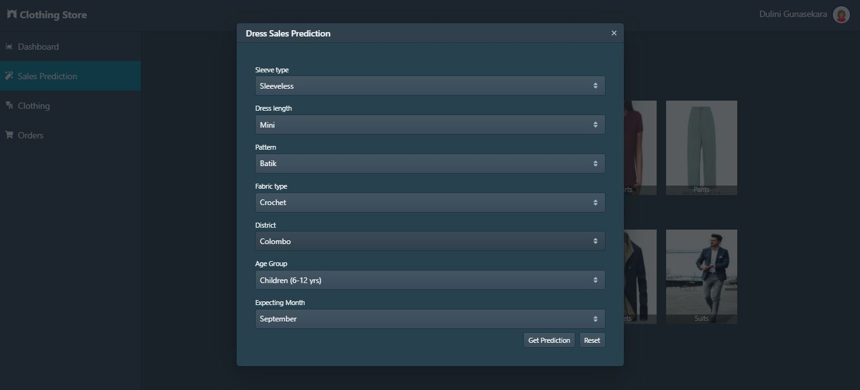
Sales Prediction Form
IT17084796 | H.S.D.N Gunasekara | 2021-153

Slide 54
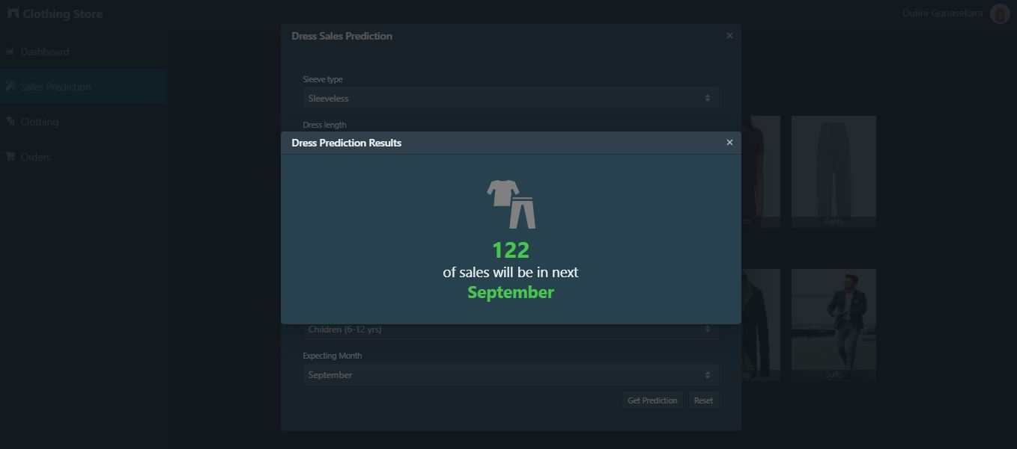
Predicted Result
IT17084796 | H.S.D.N Gunasekara | 2021-153

Slide 55
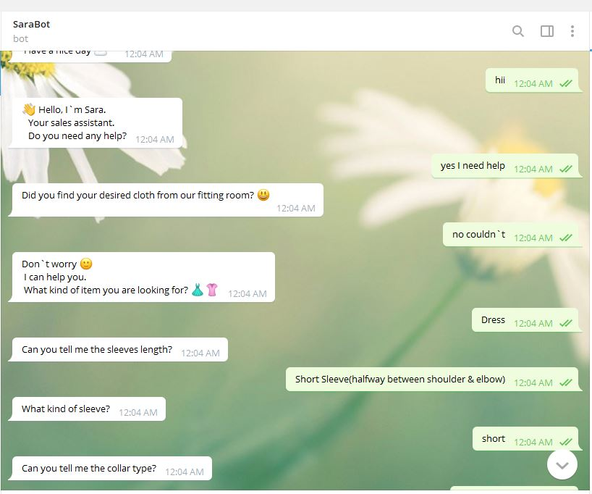
Implemented the basic conversational model for AI chatbot assistant
Implement a ML model for suggest a clothing item
AI chatbot conversation
IT17084796 | H.S.D.N Gunasekara | 2021-153

Slide 56
Demonstration
IT17084796 | H.S.D.N Gunasekara | 2021-153

Slide 57
References
[9] S.Priyadharsun, S.Lakshigan, S.S Baheerathan, S.Rajasooriyar, U.U.S.K. Rajapaksha and S.M.Buddika Harshanath, &amp;quot;Parade in the Virtual Dressing Room&amp;quot;, in International Conference on Computer Science &amp;amp; Education (ICCSE 2018), Colombo, Sri Lanka, 2018.
[10] Srinivasan K. and Vivek S., &amp;quot;Implementation Of Virtual Fitting Room Using Image Processing&amp;quot;, in IEEE International Conference on Computer, Communication and Signal Processing (ICCCSP-2017), 2017.
[11] Rong Li,KunZou, Xiang Xu,YueqiaoLi and Zan Li, &amp;quot;Research of Interactive 3D Virtual Fitting Room on Web Environment&amp;quot;, in 2011 Fourth International Symposium on Computational Intelligence and Design, 2011
[12] A. Mia and M.Yousu, &amp;quot;Business Forecasting System using Machine Learning Approach&amp;quot;, in 2021 2nd International Conference onRobotics,Electricaland Signal Processing Techniques (ICREST), 2021.
[13] M. Hasan, M.Zaharand M.Sykot, &amp;quot;Solving Onion Market Instability by Forecasting Onion Price Using Machine Learning Approach&amp;quot;, in 2020 International Conference on Computational Performance Evaluation (ComPE) North-Eastern Hill University,Shillong, Meghalaya, India. Jul 2-4, 2020 978-1-7281-6644-5/20/$31.00 ©2020 IEEE Solving Onion MarketInstabil, 2020.
[14] K.Deepik, V.Tilekyaand J. Mamatha, &amp;quot;Jollity Chatbot- A contextual AI Assistant&amp;quot;, in Proceedings of the Third International Conference on Smart Systems and Inventive Technology (ICSSIT 2020) IEEE Xplore Part Number: CFP20P17-ART; ISBN: 978-1-7281-5821-1, 2020.
[15] H.Santoso, G. Saraswat and M.Rohman, &amp;quot;DinusIntelligent Assistance (DINA) Chatbot for University Admission Services&amp;quot;, in 2018 International Seminar on Application for Technology of Information and Communication (iSemantic), 2018.
[16] Thomas N T, &amp;quot;An E-business Chatbot using AIML and LSA&amp;quot;, in 2016 Intl. Conference on Advances in Computing, Communications and Informatics (ICACCI), Sept. 21-24, 2016, Jaipur, India, 2016
IT17084796 | H.S.D.N Gunasekara | 2021-153

Slide 58
Any Questions?

